Slide 1



MASTERS IN PROJECT MANAGEMENT
PROJECT RISK
MANAGEMENT
Class: MS(PM)-2(A,B&C)

Slide 2
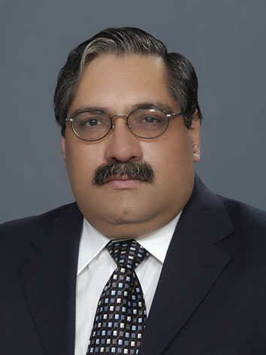
Instructor
Suhail Iqbal
PE, PMP, PgMP, PME, MCT, PRINCE2 Practitioner.
PE, PMP, PgMP, PME, MCT, PRINCE2 Practitioner.
Notes:
Custom animation effects: horizontal scrolling text
(Basic)
To reproduce the text effects on this slide, do the following:
On the Home tab, in the Slides group, click Layout, and then click Blank.
On the Insert tab, in the Text group, click Text Box, and then on the slide, drag to draw the text box.
Enter text in the text box. (Note: You may want to add a bullet point at the end of your text, as in the example above. On the Insert tab, in the Text group, click Symbol. In the Symbol dialog box, in the Font list, select (normal text). In the Subset list, select General Punctuation. In the Character Code box, enter 2022 to select BULLET, and then click Insert.)
Select the text. On the Home tab, in the Font group, do the following:
In the Font list, select Gill Sans MT.
In the Font Size list, select 36.
Click Bold.
Click the arrow next to Font Color, and then under Theme Colors click White, Background 1 (first row, first option from the left).
On the Home tab, in the Paragraph group, click Align Text Left to align the text left in the text box. (Note: If the text wraps to more than one line, drag the adjustment handles on the text box to widen it until the text fits on one line.)
Drag the text box to the left of the lower left edge of the slide. (Note: To see beyond the edges of the slide, on the View tab, click Zoom, and then in the Zoom dialog box, in the Percent box, enter 40%.)
To reproduce the animation effects on this slide, do the following:
On the Animations tab, in the Animations group, click Custom Animation.
On the slide, select the text box. In the Custom Animation task pane, do the following:
Click Add Effect, point to Entrance, and then click More Effects. In the Add Entrance Effect dialog box, under Basic, click Fly In.
Select the animation effect (fly-in effect for the text box). Click the arrow to the right of the select effect, and then click Effect Options. In the Fly In dialog box, do the following:
On the Effect tab, in the Direction list, select From Right.
On the Timing tab, do the following:
In the Start list, select With Previous.
In the Speed box, enter 16 seconds.
In the Repeat list, select Until End of Slide.
On the slide, select the text box. On the Home tab, in the Clipboard group, click the arrow under Paste, and then click Duplicate.
In the Custom Animation task pane, select the second animation effect (fly-in effect for the second text box). Click the arrow to the right of the selected effect, and then click Timing. In the Fly In dialog box, on the Timing tab, in the Delay box, enter 8. (Note: You may need to adjust the delay time if the length of your text is different than the example above.)
On the slide, drag the second text box on top of the first text box.
On the Home tab, in the Editing group, click Select, and then click Selection Pane.
In the Selection and Visibility pane, press and hold CTRL, and then select both text boxes. On the Home tab, in the Drawing group, click Arrange, point to Align, and then do the following:
Click Align Selected Objects.
Click Align Middle.
Click Align Center.
To reproduce the background effects on this slide, do the following:
Right-click the slide background area, and then click Format Background. In the Format Background dialog box, click Fill in the left pane, and then select Picture or texture fill in the Fill pane. Under Insert from, click File. In the Insert Picture dialog box, select a picture, and then click Insert.
On the Home tab, in the Drawing group, click Shapes, and then under Rectangles click Rectangle (first option from the left). On the slide, drag to draw a rectangle.
Select the rectangle. Under Drawing Tools, on the Format tab, in the Size group, do the following:
In the Shape Height box, enter 7.5”.
In the Shape Width box, enter 1”.
Under Drawing Tools, on the Format tab, in the Shape Styles group, click the arrow next to Shape Outline, and then click No Outline.
On the Home Tab, in the Drawing group, click the arrow next to Shape Fill, point to Gradient, and then click More Gradients. In the Format Shape dialog box, click Fill in the left pane, select Gradient fill in the Fill pane, and then do the following:
In the Type list, select Linear.
Click the button next to Direction, and then click Linear Right (first row, fourth option from the left).
Under Gradient stops, click Add or Remove until two stops appear in the drop-down list.
Also under Gradient stops, customize the gradient stops that you added as follows:
Select Stop 1 from the list, and then do the following:
In the Stop position box, enter 0%.
Click the button next to Color, and then under Theme Colors click Black, Text 1 (first row, second option from the left).
In the Transparency box, enter 0%.
Select Stop 2 from the list, and then do the following:
In the Stop position box, enter 100%.
Click the button next to Color, and then under Theme Colors click Black, Text 1, (first row, second option from the left).
In the Transparency box, enter 100%.
On the slide, select the rectangle. On the Home tab, in the Drawing group, click Arrange, point to Align, and then do the following:
Click Align to Slide.
Click Align Left.
Click Align Middle.
Select the rectangle. On the Home tab, in the Clipboard group, click the arrow under Paste, and then click Duplicate.
Select the duplicate rectangle. On the Home Tab, in the Drawing group, click the arrow next to Shape Fill, point to Gradient, and then click Linear Left (second row, third option from the left).
With the duplicate rectangle still selected, on the Home tab, in the Drawing group, click Arrange, point to Align, and then do the following:
Click Align to Slide.
Click Align Right.
Click Align Middle.

Slide 3
SYLLABUS
Unit | Content | Learning Objectives
7. Identify Risk | Purpose and Objective of the Identify Risk Process Critical Success Factors for the Identify Risk Process Tools & Techniques for the Identify Risk Process Documenting the Results of the Identify Risk Process The Detailed Discussion – Inputs, Process itself, Tools & techniques, Methods and Outputs. | Understand the process of Identify Risks clearly outlining the various risk types, sources, categories and factors that can be considered and what Inputs, Outputs, Tools and Techniques can be used for the same.

Slide 4
UNIT 7
UNIT 7
IDENIFY RISK PROCESS
PROJECT RISK
MANAGEMENT
Class: MS(PM)-2 (A,B&C)

Slide 5
IDENTIFY RISK PROCESS
LEARNING OBJECTIVE
UNIT 7
Understand the process of Identify Risks clearly outlining the various risk types, sources, categories and factors that can be considered and what Inputs, Outputs, Tools and Techniques can be used for the same.
Notes:
RISK MANAGEMENT PROCESSES
LEARNING OBJECTIVE
Understand the role of Project Risk management in the overall Project management and define specifically the Project Risk Management Processes

Slide 6
IDENTIFY RISK PROCESS
CONTENT
UNIT 7
Purpose and Objective of the Identify Risk Process
Critical Success Factors for the Identify Risk Process
Tools & Techniques for the Identify Risk Process
Documenting the Results of the Identify Risk Process
The Detailed Discussion – Inputs, Process itself, Tools & Techniques, Methods and Outputs.
Notes:
RISK MANAGEMENT PROCESSES
CONTENT
Role of Project Risk Management in Project Management
Project Risk Management Processes
Plan Risk Management
Identify Risks
Perform Qualitative Risk Management
Perform Quantitative Risk Management
Plan Risk Responses
Monitor and Control Risks

Slide 7
IDENTIFY RISK PROCESS
Purpose and Objectives
UNIT 7
A risk cannot be managed unless it is first identified.
After Risk management Planning has been completed,
  the first process in the iterative Project Risk Management process
  aims to identify all the knowable risks to project objectives.
From Practice Standard for Project Risk Management, 1st Ed, PMI

Slide 8
IDENTIFY RISK PROCESS
Purpose – Risk Exposure Changes
UNIT 7
It is, however, impossible to identify all the risks at the outset of a project.
Over time, the level of project risk exposure changes as a result of
  Internal changes - the decisions and actions taken previously in the project, and
  Externally imposed changes
From Practice Standard for Project Risk Management, 1st Ed, PMI

Slide 9
IDENTIFY RISK PROCESS
Purpose – Unknowable or Emergent
UNIT 7
The purpose of risk identification is to identify risks to the maximum extent that is practicable.
The fact that some risks are unknowable or emergent requires the Identify Risk process to be iterative, repeating the Identify Risks process to find new risks which have become knowable since the previous iteration of the process.
From Practice Standard for Project Risk Management, 1st Ed, PMI
Notes:
ROLE OF PROJECT RISK MGMT
In Corporate Business Management
Two Basic Types in Corporate Business Management:-
Business Risk
Inherent chances of both profit and loss associated with the particular business endeavor.
Business entities employ skilled staff to increase the chances of profit and reduce the chances of loss.
The essential purpose is to maximize profits.
Pure or Insurable Risk
Involves only a chance for loss and no chance for profit.
Insurable risks can be further sub-divided into four categories:-
Direct property loss
Indirect property loss
Liability loss
Personal loss

Slide 10
IDENTIFY RISK PROCESS
Purpose – Potential Responses
UNIT 7
When a risk is first identified, potential responses may also be identified at the same time.
These should be recorded during the Identify Risks process and considered for immediate action is such action is appropriate.
Where such responses are not implemented immediately, these should be considered during the Plan Risk Responses process.
From Practice Standard for Project Risk Management, 1st Ed, PMI
Notes:
ROLE OF PROJECT RISK MGMT
In Corporate Business Management
Two Basic Types in Corporate Business Management:-
Business Risk
Inherent chances of both profit and loss associated with the particular business endeavor.
Business entities employ skilled staff to increase the chances of profit and reduce the chances of loss.
The essential purpose is to maximize profits.
Pure or Insurable Risk
Involves only a chance for loss and no chance for profit.
Insurable risks can be further sub-divided into four categories:-
Direct property loss
Indirect property loss
Liability loss
Personal loss

Slide 11
IDENTIFY RISK PROCESS
Objectives
UNIT 7
The objectives of the Identify Risks process are to:
Identify and record a long list of threats and opportunities for the project and by work package; for many projects, the word “long” means hundreds of risks
Make sure all risks are in the cause-risk-effect format
Understand the risks
From Practice Standard for Project Risk Management, 1st Ed, PMI
Notes:
ROLE OF PROJECT RISK MGMT
In Corporate Business Management
Two Basic Types in Corporate Business Management:-
Business Risk
Inherent chances of both profit and loss associated with the particular business endeavor.
Business entities employ skilled staff to increase the chances of profit and reduce the chances of loss.
The essential purpose is to maximize profits.
Pure or Insurable Risk
Involves only a chance for loss and no chance for profit.
Insurable risks can be further sub-divided into four categories:-
Direct property loss
Indirect property loss
Liability loss
Personal loss

Slide 12
IDENTIFY RISK PROCESS
Risk Types and Categories
UNIT 7
  Types
  Business (profit or loss) and insurable (loss)
  Known known Total certainty
  Known unknown Degree of uncertainty
  Unknown unknown Total uncertainty
  Categories
  External, unpredictable Regulatory, etc.
  External, predictable Market risks
  Internal, non-technical Management
  Technical Design
  Legal Contractual

Slide 13
UNIT 7
IDENTIFY RISK PROCESS
Critical Success Factors

Slide 14
IDENTIFY RISK PROCESS
Critical Success Factors
5.2.1 Early Identification
UNIT 7
Risk Identification should be performed as early as possible in the project lifecycle, recognizing the paradox that uncertainty is high in the initial stages of a project so there is often less information on which to base the risk identification.
Early risk identification enables key project decisions to take maximum account of risks inherent in the project, and may result in changes to the project strategy.
It also maximizes the time available for development and implementation of risk responses, which enhances efficiency since responses taken early are often normally less costly than later ones.
From Practice Standard for Project Risk Management, 1st Ed, PMI
Notes:
ROLE OF PROJECT RISK MGMT
In Corporate Business Management
Two Basic Types in Corporate Business Management:-
Business Risk
Inherent chances of both profit and loss associated with the particular business endeavor.
Business entities employ skilled staff to increase the chances of profit and reduce the chances of loss.
The essential purpose is to maximize profits.
Pure or Insurable Risk
Involves only a chance for loss and no chance for profit.
Insurable risks can be further sub-divided into four categories:-
Direct property loss
Indirect property loss
Liability loss
Personal loss

Slide 15
IDENTIFY RISK PROCESS
Critical Success Factors
5.2.2 Iterative Identification
UNIT 7
Since not all risks can be identified at any given point in the project, it is essential that risk identification is repeated throughout the project life cycle.
This should be done periodically, at a frequency determined during the Plan Risk Management process.
Risk Identification might also be repeated at key milestones in the project, or whenever there is significant change to the project or its operating environment.
From Practice Standard for Project Risk Management, 1st Ed, PMI
Notes:
ROLE OF PROJECT RISK MGMT
In Corporate Business Management
Two Basic Types in Corporate Business Management:-
Business Risk
Inherent chances of both profit and loss associated with the particular business endeavor.
Business entities employ skilled staff to increase the chances of profit and reduce the chances of loss.
The essential purpose is to maximize profits.
Pure or Insurable Risk
Involves only a chance for loss and no chance for profit.
Insurable risks can be further sub-divided into four categories:-
Direct property loss
Indirect property loss
Liability loss
Personal loss

Slide 16
IDENTIFY RISK PROCESS
Critical Success Factors
5.2.3 Emergent Identification
UNIT 7
In addition to invoking the Identify Risks process as defined in the project plan, the Plan Risk Management process should permit
  risks to be identified at any time,
  not limited to
    formal risk identification events or
    regular reviews.
From Practice Standard for Project Risk Management, 1st Ed, PMI
Notes:
ROLE OF PROJECT RISK MGMT
In Corporate Business Management
Two Basic Types in Corporate Business Management:-
Business Risk
Inherent chances of both profit and loss associated with the particular business endeavor.
Business entities employ skilled staff to increase the chances of profit and reduce the chances of loss.
The essential purpose is to maximize profits.
Pure or Insurable Risk
Involves only a chance for loss and no chance for profit.
Insurable risks can be further sub-divided into four categories:-
Direct property loss
Indirect property loss
Liability loss
Personal loss

Slide 17
IDENTIFY RISK PROCESS
Critical Success Factors
5.2.4 Comprehensive Identification
UNIT 7
A broad range of sources of risk should be considered to ensure that as many uncertainties as possible that might affect objectives have been identified.
From Practice Standard for Project Risk Management, 1st Ed, PMI
Notes:
ROLE OF PROJECT RISK MGMT
In Corporate Business Management
Two Basic Types in Corporate Business Management:-
Business Risk
Inherent chances of both profit and loss associated with the particular business endeavor.
Business entities employ skilled staff to increase the chances of profit and reduce the chances of loss.
The essential purpose is to maximize profits.
Pure or Insurable Risk
Involves only a chance for loss and no chance for profit.
Insurable risks can be further sub-divided into four categories:-
Direct property loss
Indirect property loss
Liability loss
Personal loss

Slide 18
IDENTIFY RISK PROCESS
Critical Success Factors
5.2.5 Explicit Identification of Opportunities
UNIT 7
The Identify Risks process should ensure opportunities are properly considered.
From Practice Standard for Project Risk Management, 1st Ed, PMI
Notes:
ROLE OF PROJECT RISK MGMT
In Corporate Business Management
Two Basic Types in Corporate Business Management:-
Business Risk
Inherent chances of both profit and loss associated with the particular business endeavor.
Business entities employ skilled staff to increase the chances of profit and reduce the chances of loss.
The essential purpose is to maximize profits.
Pure or Insurable Risk
Involves only a chance for loss and no chance for profit.
Insurable risks can be further sub-divided into four categories:-
Direct property loss
Indirect property loss
Liability loss
Personal loss

Slide 19
IDENTIFY RISK PROCESS
Critical Success Factors
5.2.6 Multiple Perspectives
UNIT 7
The Identify Risks process should take input from a broad range of project stakeholders to ensure that all perspectives are represented and considered.
Limiting risk identification to the immediate project team is unlikely to expose all knowable risks.
From Practice Standard for Project Risk Management, 1st Ed, PMI
Notes:
ROLE OF PROJECT RISK MGMT
In Corporate Business Management
Two Basic Types in Corporate Business Management:-
Business Risk
Inherent chances of both profit and loss associated with the particular business endeavor.
Business entities employ skilled staff to increase the chances of profit and reduce the chances of loss.
The essential purpose is to maximize profits.
Pure or Insurable Risk
Involves only a chance for loss and no chance for profit.
Insurable risks can be further sub-divided into four categories:-
Direct property loss
Indirect property loss
Liability loss
Personal loss

Slide 20
IDENTIFY RISK PROCESS
Critical Success Factors
5.2.7 Risks Linked to Project Objectives
UNIT 7
Each identified project risk should relate to at least one project objective (time, cost, quality, scope, etc.), noting that the PMBOK® Guide defines risk as an uncertain event or condition that, if it occurs, has a positive or a negative effect on a project’s objectives.
Consideration of each project objective during the Identify Risks process will assist in identifying risks, noting that some risks may affect more than one objective.
From Practice Standard for Project Risk Management, 1st Ed, PMI
Notes:
ROLE OF PROJECT RISK MGMT
In Corporate Business Management
Two Basic Types in Corporate Business Management:-
Business Risk
Inherent chances of both profit and loss associated with the particular business endeavor.
Business entities employ skilled staff to increase the chances of profit and reduce the chances of loss.
The essential purpose is to maximize profits.
Pure or Insurable Risk
Involves only a chance for loss and no chance for profit.
Insurable risks can be further sub-divided into four categories:-
Direct property loss
Indirect property loss
Liability loss
Personal loss

Slide 21
IDENTIFY RISK PROCESS
Critical Success Factors
5.2.8 Complete Risk Statement
UNIT 7
Identified risks should be clearly and unambiguously described, so that they can be understood by those responsible for risk assessment and risk response planning.
Single words or phrases such as “resources” or “logistics” are inadequate and do not properly communicate the nature of the risk.
More detailed risk description are required which explicitly state the uncertainty and its causes and effects.
From Practice Standard for Project Risk Management, 1st Ed, PMI
Notes:
ROLE OF PROJECT RISK MGMT
In Corporate Business Management
Two Basic Types in Corporate Business Management:-
Business Risk
Inherent chances of both profit and loss associated with the particular business endeavor.
Business entities employ skilled staff to increase the chances of profit and reduce the chances of loss.
The essential purpose is to maximize profits.
Pure or Insurable Risk
Involves only a chance for loss and no chance for profit.
Insurable risks can be further sub-divided into four categories:-
Direct property loss
Indirect property loss
Liability loss
Personal loss

Slide 22
IDENTIFY RISK PROCESS
Critical Success Factors
5.2.9 Ownership and Level of Detail
UNIT 7
Risks can be identified at a number of level of detail.
A generalized or high-level description of risk can make it difficult to develop responses and assign ownership, while describing risks in a lot of detail can create a great deal of work.
Each risk should be described at a level of detail at which it can be assigned to a single risk owner with clear responsibility and accountability for its management.
Trigger conditions should also be identified where this is possible and appropriate.
From Practice Standard for Project Risk Management, 1st Ed, PMI
Notes:
ROLE OF PROJECT RISK MGMT
In Corporate Business Management
Two Basic Types in Corporate Business Management:-
Business Risk
Inherent chances of both profit and loss associated with the particular business endeavor.
Business entities employ skilled staff to increase the chances of profit and reduce the chances of loss.
The essential purpose is to maximize profits.
Pure or Insurable Risk
Involves only a chance for loss and no chance for profit.
Insurable risks can be further sub-divided into four categories:-
Direct property loss
Indirect property loss
Liability loss
Personal loss

Slide 23
IDENTIFY RISK PROCESS
Critical Success Factors
5.2.10 Objectivity
UNIT 7
All human activities are susceptible to bias, especially when dealing with uncertainty.
Following two types of biases may occur:
  Motivational biases, where someone is trying to bias the result in one direction or another, or
  Cognitive biases, where biases occur as people are using their best judgment and applying heuristics.
This should be explicitly recognized and addressed during the Identify Risks process.
Sources of bias should be exposed wherever possible, and their effect on the risk process should be managed proactively.
The aim is to minimize subjectivity, and allow open and honest identification of as many risks as possible to the project.
From Practice Standard for Project Risk Management, 1st Ed, PMI
Notes:
ROLE OF PROJECT RISK MGMT
In Corporate Business Management
Two Basic Types in Corporate Business Management:-
Business Risk
Inherent chances of both profit and loss associated with the particular business endeavor.
Business entities employ skilled staff to increase the chances of profit and reduce the chances of loss.
The essential purpose is to maximize profits.
Pure or Insurable Risk
Involves only a chance for loss and no chance for profit.
Insurable risks can be further sub-divided into four categories:-
Direct property loss
Indirect property loss
Liability loss
Personal loss

Slide 24
UNIT 7
IDENTIFY RISK PROCESS
Tools and Techniques

Slide 25
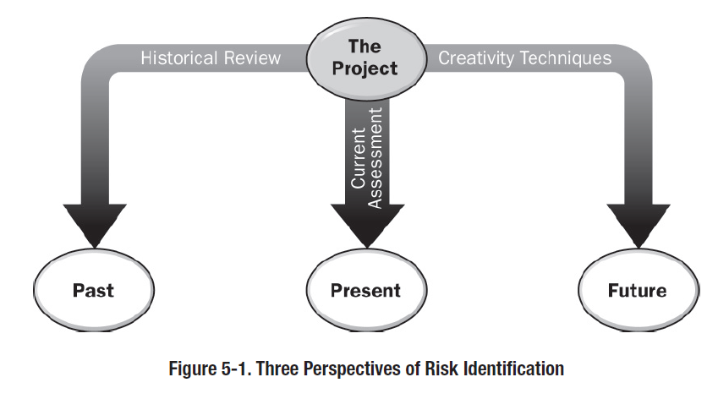
IDENTIFY RISK PROCESS
Tools and Techniques
UNIT 7
Three Categories:
From Practice Standard for Project Risk Management, 1st Ed, PMI
Notes:
ROLE OF PROJECT RISK MGMT
In Corporate Business Management
Two Basic Types in Corporate Business Management:-
Business Risk
Inherent chances of both profit and loss associated with the particular business endeavor.
Business entities employ skilled staff to increase the chances of profit and reduce the chances of loss.
The essential purpose is to maximize profits.
Pure or Insurable Risk
Involves only a chance for loss and no chance for profit.
Insurable risks can be further sub-divided into four categories:-
Direct property loss
Indirect property loss
Liability loss
Personal loss

Slide 26
IDENTIFY RISK PROCESS
Tools and Techniques
5.3.1 Historical Review
UNIT 7
Historical reviews are based on what occurred in the past, either on this project, or other similar projects in the same organization, or comparable projects in other organizations.
Historical review approaches rely on careful selection of comparable situations which are genuinely similar to the current project, and filtering of data to ensure that only relevant previous risks are considered.
In each case, the risks identified in the selected historical situation should be considered, asking whether they or similar risks might arise in this project.
From Practice Standard for Project Risk Management, 1st Ed, PMI
Notes:
ROLE OF PROJECT RISK MGMT
In Corporate Business Management
Two Basic Types in Corporate Business Management:-
Business Risk
Inherent chances of both profit and loss associated with the particular business endeavor.
Business entities employ skilled staff to increase the chances of profit and reduce the chances of loss.
The essential purpose is to maximize profits.
Pure or Insurable Risk
Involves only a chance for loss and no chance for profit.
Insurable risks can be further sub-divided into four categories:-
Direct property loss
Indirect property loss
Liability loss
Personal loss

Slide 27
IDENTIFY RISK PROCESS
Tools and Techniques
5.3.2 Current Assessments
UNIT 7
Current Assessments rely on detailed consideration of the current project, analyzing its characteristics against given frameworks and models in order to expose areas of uncertainty.
Unlike historical review approaches, current assessment techniques do not rely on outside reference points, but are based purely on examination of the project.
From Practice Standard for Project Risk Management, 1st Ed, PMI
Notes:
ROLE OF PROJECT RISK MGMT
In Corporate Business Management
Two Basic Types in Corporate Business Management:-
Business Risk
Inherent chances of both profit and loss associated with the particular business endeavor.
Business entities employ skilled staff to increase the chances of profit and reduce the chances of loss.
The essential purpose is to maximize profits.
Pure or Insurable Risk
Involves only a chance for loss and no chance for profit.
Insurable risks can be further sub-divided into four categories:-
Direct property loss
Indirect property loss
Liability loss
Personal loss

Slide 28
IDENTIFY RISK PROCESS
Tools and Techniques
5.3.3 Creativity Techniques
UNIT 7
A wide range of creativity techniques can be used for risk identification, which encourages project stakeholders to use their imagination to find risks which might affect the project.
The outcomes or effectiveness of these techniques depend on the ability of participants to think creatively.
These techniques can be used either singly or in groups, and employ varying degrees of structure.
These techniques depend on the ability of participants to think creatively, and their success is enhanced by use of a skilled facilitator.
From Practice Standard for Project Risk Management, 1st Ed, PMI
Notes:
ROLE OF PROJECT RISK MGMT
In Corporate Business Management
Two Basic Types in Corporate Business Management:-
Business Risk
Inherent chances of both profit and loss associated with the particular business endeavor.
Business entities employ skilled staff to increase the chances of profit and reduce the chances of loss.
The essential purpose is to maximize profits.
Pure or Insurable Risk
Involves only a chance for loss and no chance for profit.
Insurable risks can be further sub-divided into four categories:-
Direct property loss
Indirect property loss
Liability loss
Personal loss

Slide 29
IDENTIFY RISK PROCESS
Tools and Techniques
UNIT 7
Each category of risk identification technique has strengths and weaknesses, and no single technique can be expected to reveal all knowable risks.
Consequently, the Identify Risks process for a particular project should use a combination of techniques, perhaps selecting one from each category.
For example, a project may choose to use a risk identification checklist (historical review), together with assumptions analysis (current assessment) and brainstorming (creativity).
Use of a risk breakdown structure which organizes the categories of potential risks on the project, a prompt list, or a set of generic list categories may assist in ensuring that as many sources of risk as practicable have been addressed, while recognizing that no such tools are complete nor can they replace original thinking.
From Practice Standard for Project Risk Management, 1st Ed, PMI
Notes:
ROLE OF PROJECT RISK MGMT
In Corporate Business Management
Two Basic Types in Corporate Business Management:-
Business Risk
Inherent chances of both profit and loss associated with the particular business endeavor.
Business entities employ skilled staff to increase the chances of profit and reduce the chances of loss.
The essential purpose is to maximize profits.
Pure or Insurable Risk
Involves only a chance for loss and no chance for profit.
Insurable risks can be further sub-divided into four categories:-
Direct property loss
Indirect property loss
Liability loss
Personal loss

Slide 30
IDENTIFY RISK PROCESS
Tools and Techniques
UNIT 7
Whichever risk identification techniques are used, it is important that identified risks are unambiguously described in order to ensure that the project risk process is focused on the actual risks and not distracted or diluted by non-risks.
Use of structured risk descriptions can ensure clarity.
Risk meta-language offers a useful way of distinguishing a risk from its cause(s) and effect(s), describing each risk using three-part statements in the form:-
“as a result of cause, risk may occur, which would lead to effect.”
From Practice Standard for Project Risk Management, 1st Ed, PMI
Notes:
ROLE OF PROJECT RISK MGMT
In Corporate Business Management
Two Basic Types in Corporate Business Management:-
Business Risk
Inherent chances of both profit and loss associated with the particular business endeavor.
Business entities employ skilled staff to increase the chances of profit and reduce the chances of loss.
The essential purpose is to maximize profits.
Pure or Insurable Risk
Involves only a chance for loss and no chance for profit.
Insurable risks can be further sub-divided into four categories:-
Direct property loss
Indirect property loss
Liability loss
Personal loss

Slide 31
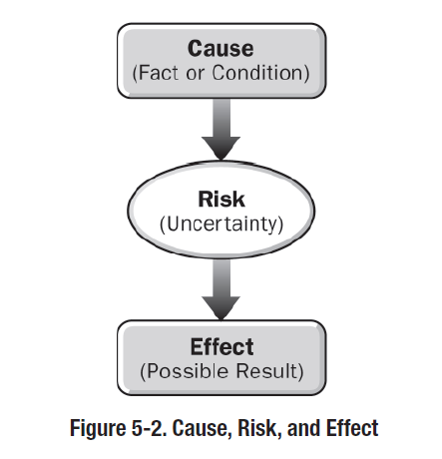
IDENTIFY RISK PROCESS
Tools and Techniques
UNIT 7
The relationship between cause, risk, and effect is shown as under:-
From Practice Standard for Project Risk Management, 1st Ed, PMI
Notes:
ROLE OF PROJECT RISK MGMT
In Corporate Business Management
Two Basic Types in Corporate Business Management:-
Business Risk
Inherent chances of both profit and loss associated with the particular business endeavor.
Business entities employ skilled staff to increase the chances of profit and reduce the chances of loss.
The essential purpose is to maximize profits.
Pure or Insurable Risk
Involves only a chance for loss and no chance for profit.
Insurable risks can be further sub-divided into four categories:-
Direct property loss
Indirect property loss
Liability loss
Personal loss

Slide 32
UNIT 7
IDENTIFY RISK PROCESS
Documenting the Results

Slide 33
IDENTIFY RISK PROCESS
Documenting the Results
UNIT 7
The results from the Identify Risk process should be recorded in order to capture all relevant information currently available for each identified risk.
The main output from the Identify Risks process is the risk register.
This includes a properly structured risk description and the nominated risk owner for each risk, and may also include information on the causes and effects of the risk register, trigger conditions, and preliminary responses.
From Practice Standard for Project Risk Management, 1st Ed, PMI
Notes:
ROLE OF PROJECT RISK MGMT
In Corporate Business Management
Two Basic Types in Corporate Business Management:-
Business Risk
Inherent chances of both profit and loss associated with the particular business endeavor.
Business entities employ skilled staff to increase the chances of profit and reduce the chances of loss.
The essential purpose is to maximize profits.
Pure or Insurable Risk
Involves only a chance for loss and no chance for profit.
Insurable risks can be further sub-divided into four categories:-
Direct property loss
Indirect property loss
Liability loss
Personal loss

Slide 34
UNIT 7
IDENTIFY RISK PROCESS
The Detailed Discussion

Slide 35
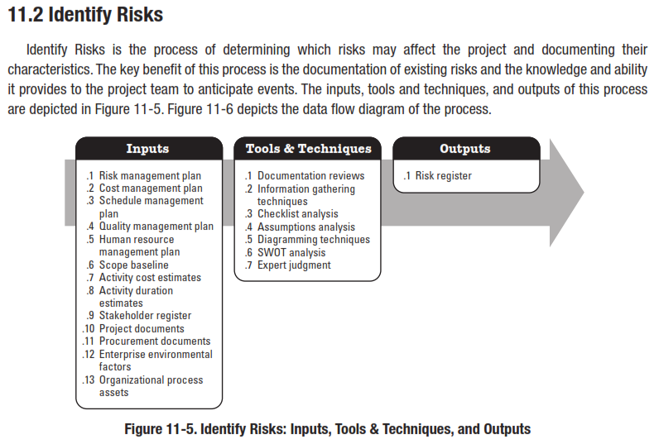

Slide 36
8
2
Identify Risks
Risk
Planning
Process 11.2
Process of determining which risks may affect the project and documenting their characteristics.
11.2
Inputs
1
Tools and Techniques
2
Outputs
3
Risk Management Plan
Activity Cost Estimates
Activity Duration Estimates
Scope Baseline
Stakeholder Register
Cost Management Plan
Schedule Management Plan
Quality Management Plan
Project Documents
Enterprise Environmental Factors
Organizational Process Assets
____________
Documentation Reviews
Information Gathering Techniques
Checklist Analysis
Assumptions Analysis
Diagramming Techniques
SWOT Analysis
Expert Judgment
___________
Risk Register
____________
Reference: Figure 11.6.
PMBOK® Guide, 4th Ed
Notes:
Picture with three text columns
(Intermediate)
To reproduce the picture effects on this slide, do the following:
On the Home tab, in the Slides group, click Layout, and then click Blank.
On the Insert tab, in the Illustrations group, click Picture.
In the Insert Picture dialog box, select a picture and then click Insert.
Select the picture. Under Picture Tools, on the Format tab, in the bottom right corner of the Size group, click the Size and Position dialog box launcher.
In the Size and Position dialog box, on the Size tab, resize or crop the picture as needed so that under Size and rotate, the Height box is set to 1.48” and the Width box is set to 9.17”. Resize the picture under Size and rotate by entering values into the Height and Width boxes. Crop the picture under Crop from by entering values into the Left, Right, Top, and Bottom boxes.
On the Home tab, in the bottom right corner of the Drawing group, click the Format Shape dialog box launcher. In the Format Shape dialog box, click Line Color in the left pane, select Gradient line in the right pane, and then do the following:
In the Type list, select Linear.
Click the button next to Direction, and then click Linear Up (second row, second option from the left).
Under Gradient stops, click Add or Remove until two stops appear in the drop-down list.
Also under Gradient stops, customize the gradient stops that you added as follows:
Select Stop 1 from the list, and then do the following:
In the Stop position box, enter 0%.
Click the button next to Color, and then under Theme Colors click White, Background 1 (first row, first option from the left).
Select Stop 2 from the list, and then do the following:
In the Stop position box, enter 100%.
Click the button next to Color, and then under Theme Colors click White, Background 1, Darker 25% (fourth row, first option from the left).
Also in the Format Shape dialog box, click Line Style in the left pane, and then in the right pane, in the Width box, enter 1 pt.
On the Home tab, in the Drawing group, click Shape Effects, point to Glow, and then do the following:
Under Glow Variations, select any option in the first row (5 pt glow options).
Point to More Glow Colors, and then under Theme Colors click White, Background 1, Darker 25% (fourth row, first option from the left).
On the Home tab, in the Drawing group, click Arrange, point to Align, and then click Align Center.
To reproduce the first column heading on this slide, do the following:
On the Home tab, in the Drawing group, click Shapes, and then under Rectangles, click Rectangle (first option from the left). On the slide, drag to draw a rectangle.
Under Drawing Tools, on the Format tab, in the Size group, do the following:
In the Shape Height box, enter 1”.
In the Shape Width box, enter 2.92”.
On the Home tab, in the bottom right corner of the Drawing group, click the Format Shape dialog box launcher. In the Format Shape dialog box, click Fill in the left pane, select Gradient fill in the right pane, and then do the following:
In the Type list, select Linear.
Click the button next to Direction, and then click Linear Down (first row, second option from the left).
Under Gradient stops, click Add or Remove until two stops appear in the drop-down list.
Also under Gradient stops, customize the gradient stops that you added as follows:
Select Stop 1 from the list, and then do the following:
In the Stop position box, enter 32%.
Click the button next to Color, and then under Theme Colors click Tan, Background 2 (first row, third option from the left).
Select Stop 2 from the list, and then do the following:
In the Stop position box, enter 100%.
Click the button next to Color, and then under Theme Colors click Tan, Background 2, Darker 25% (third row, third option from the left).
Also in the Format Shape dialog box, click Line Color in the left pane, select Gradient line in the Line Color pane, and then do the following:
In the Type list, select Linear.
Click the button next to Direction, and then click Linear Up (second row, second option from the left).
Under Gradient stops, click Add or Remove until two stops appear in the drop-down list.
Also under Gradient stops, customize the gradient stops that you added as follows:
Select Stop 1 from the list, and then do the following:
In the Stop position box, enter 0%.
Click the button next to Color, and then under Theme Colors click White, Background 1 (first row, first option from the left).
Select Stop 2 from the list, and then do the following:
In the Stop position box, enter 100%.
Click the button next to Color, and then under Theme Colors click White, Background 1, Darker 25% (fourth row, first option from the left).
Also in the Format Shape dialog box, click Line Style in the left pane. In the right pane, in the Width box, enter 1 pt.
On the Home tab, in the Drawing group, click Shape Effects, point to Glow, and then do the following:
Under Glow Variations, select any option in the first row (5 pt glow options).
Point to More Glow Colors, and then under Theme Colors click White, Background 1, Darker 25% (fourth row, first option from the left).
On the slide, right-click the rectangle and then click Edit Text.
Enter text in the text box and select the text. On the Home tab, in the Font group, select Gill Sans MT from the Font list and then select 24 from the Font Size list.
On the Home tab, in the Paragraph group, click Align Text Left to align the text left within the text box.
Under Drawing Tools, on the Format tab, in the WordArt Styles group, click the arrow next to Text Fill, and then under Theme Colors click Tan, Background 2, Darker 75% (fifth row, third option from the left).
On the Home tab, in the bottom-right corner of the Drawing group, click the Format Shapes dialog box launcher. In the Format Shapes dialog box, click Text Box in the left pane. In the right pane, under Internal margin, enter 1” in the Left box to increase the left margin in the rectangle to accommodate the embossed number.
On the Home tab, in the Drawing group, click Shapes, and then under Lines, click Line (first option from the left).
Press and hold SHIFT, and then on the slide, drag to draw a straight, vertical line.
Under Drawing Tools, on the Format tab, in the Size group, in the Width box, enter 0.75”.
On the Home tab, in the bottom-right corner of the Drawing group, click the Format Shapes dialog box launcher. In the Format Shapes dialog box, click Line Style in the left pane, and then do the following in the right pane:
In the Width box, enter 2.25 pt.
Click the button next to Dash type, and then click Round Dot (second option from the top).
Also in the Format Shapes dialog box, click Line Color in the left pane. In the right pane, click the button next to Color, and then under Theme Colors click White, Background 1 (first row, first option from the left).
On the slide, drag the line onto the rectangle, just left of the text box.
On the Insert tab, in the Text box, click Text Box and then on the slide, drag to draw another text box.
Enter 1 in the text box and select the text. On the Home tab, in the Font group, select Calisto MT from the Font list and then enter 50 in the Font Size box.
On the Home tab, in the Paragraph group, click Center to center the text within the text box.
Under Drawing Tools, on the Format tab, in the WordArt Styles group, click the arrow next to Text Fill, and then under Theme Colors click Tan, Background 2, Darker 25% (third row, third option from the left).
Drag the text box onto the rectangle, left of the dotted vertical line.
On the Home tab, in the Editing group, click Select, and then click Selection Pane.
In the Selection and Visibility pane, press and hold CTRL to select the text box, line, and rectangle.
On the Home tab, in the Drawing group, click Arrange, point to Align, and then click Align Middle.
To reproduce the other column headings on this slide, do the following:
On the Home tab, in the Editing group, click Select, and then click Selection Pane.
In the Selection and Visibility pane, press and hold CTRL to select the text box, line, and rectangle.
On the Home tab, in the Drawing group, click Arrange, and then under Group Objects click Group.
On the Home tab, in the Clipboard group, click the arrow under Paste, and then click Duplicate. Repeat the process until you have a total of three groups of shapes.
Select each group in the Selection and Visibility pane and drag it on the slide to form a row under the picture.
Also in the Selection and Visibility pane, press and hold CTRL and select all three groups. On the Home tab, in the Drawing group, click Arrange, point to Align, and then do the following:
Click Align Middle.
Click Distribute Horizontally.
To change the numbers in the duplicate text boxes (second and third from the left), click in each text box and edit the text.
To reproduce the first column (the “subtext” portion) on this slide, do the following:
On the Home tab, in the Drawing group, click Shapes, and then under Rectangles click Rectangle (first option from the left).
On the slide, drag to draw the rectangle so that the top edge is just below the first column heading and the bottom edge is at the bottom of the slide.
Under Drawing Tools, on the Format tab, in the Size group, in the Shape Width box, enter 2.92” so that the subtext column is the same width as the column heading above it.
On the Home tab, in the Drawing group, click the arrow next to Shape Outline, and then click No Outline.
On the Home tab, in the bottom right corner of the Drawing group, click the Format Shape dialog box launcher. In the Format Shape dialog box, click Fill in the left pane, select Gradient fill in the right pane, and then do the following:
In the Type list, select Linear.
Click the button next to Direction, and then click Linear Down (first row, second option from the left).
Under Gradient stops, click Add or Remove until three stops appear in the drop-down list.
Also under Gradient stops, customize the gradient stops that you added as follows:
Select Stop 1 from the list, and then do the following:
In the Stop position box, enter 0%.
Click the button next to Color, and then under Theme Colors click White, Background 1 (first row, first option from the left).
In the Transparency box, enter 100%.
Select Stop 2 from the list, and then do the following:
In the Stop position box, enter 50%.
Click the button next to Color, and then under Theme Colors click Tan, Background 2, Darker 25% (third row, third option from the left).
In the Transparency box, enter 25%.
Select Stop 3 from the list, and then do the following:
In the Stop position box, enter 100%.
Click the button next to Color, and then under Theme Colors click White, Background 1 (first row, first option from the left).
In the Transparency box, enter 100%.
On the slide, right-click the column and then click Edit Text.
Enter text in the text box and select the text. On the Home tab, in the Font group, select Gill Sans MT from the Font list and then enter 22 in the Font Size box.
On the Home tab, in the Paragraph group, click Center to center the text within the rectangle.
Under Drawing Tools, on the Format tab, in the WordArt Styles group, click the arrow next to Text Fill, and then under Theme Colors click White, Background 1, Darker 50% (sixth row, first option from the left).
On the Home tab, in the bottom-right corner of the Drawing group, click the Format Shapes dialog box launcher. In the Format Shapes dialog box, click Text Box in the left pane. In the right pane, under Text layout, in the Vertical Alignment list, select Top.
To reproduce the other columns (the “subtext” portion) on this slide, do the following:
Select the first “subtext” rectangle. On the Home tab, in the Clipboard group, click the arrow under Paste, and then click Duplicate. Repeat the process until you have a total of three “subtext” rectangles.
Drag each duplicate on the slide to form a row under the “text heading” rectangles.
Press and hold SHIFT and select all three “subtext” rectangles. On the Home tab, in the Drawing group, click Arrange, point to Align, and then click Distribute Horizontally.
To reproduce the background on this slide, do the following:
Right-click the slide background area, and then click Format Background. In the Format Background dialog box, click Fill in the left pane, select Gradient fill in the right pane, and then do the following:
In the Type list, select Radial.
Click the button next to Direction, and then click From Center (third option from the left).
Under Gradient stops, click Add or Remove until two stops appear in the drop-down list.
Also under Gradient stops, customize the gradient stops that you added as follows:
Select Stop 1 from the list, and then do the following:
In the Stop position box, enter 0%.
Click the button next to Color, and then under Theme Colors click White, Background 1 (first row, first option from the left).
Select Stop 2 from the list, and then do the following:
In the Stop position box, enter 100%.
Click the button next to Color, and then under Theme Colors click Tan, Background 2 (first row, third option from the left).

Slide 37
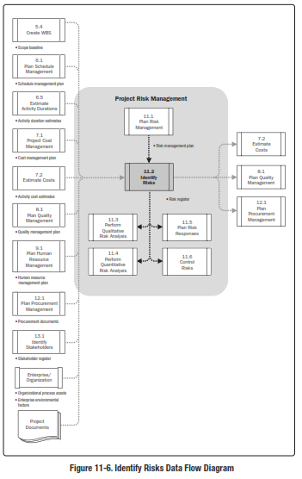
Reference: Figure 11.6.
PMBOK® Guide, 5th Ed

Slide 38
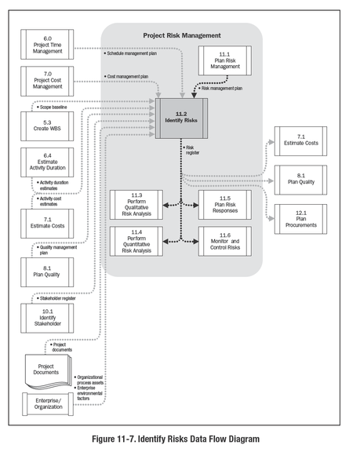
Reference: Figure 11.7.
PMBOK® Guide, 4th Ed

Slide 39
Introduction to Risk
Risk – Events or consequences that have the probability of occurring during a project and that are measured by their impacts on the project
Components
  Risk event
  Risk event probability
  Risk outcome or consequence
  (Amount at stake)
  Risk event status
  (Probability x amount at stake)

Slide 40
Risk Identification
  Types
  Business (profit or loss) and insurable (loss)
  Known known Total certainty
  Known unknown Degree of uncertainty
  Unknown unknown Total uncertainty
  Categories
  External, unpredictable Regulatory, etc.
  External, predictable Market risks
  Internal, non-technical Management
  Technical Design
  Legal Contractual

Slide 41
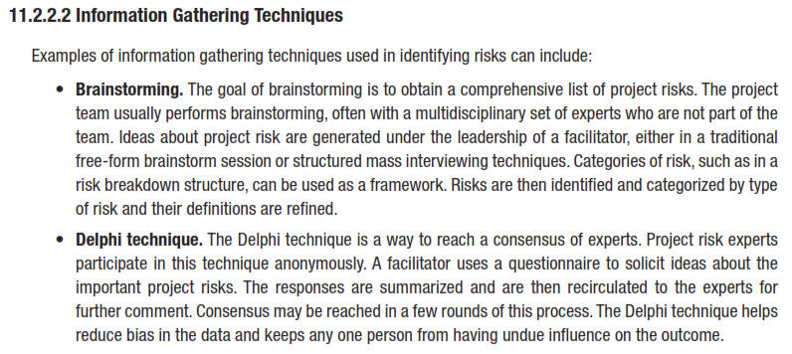
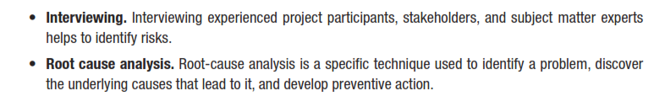
INFORMATION GATHERING

Slide 42
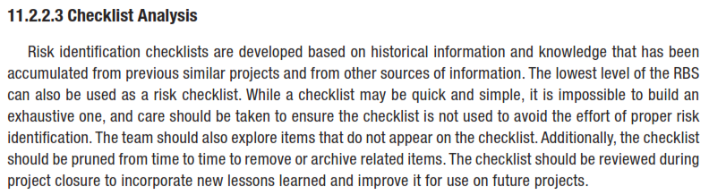
CHECKLIST ANALYSIS

Slide 43
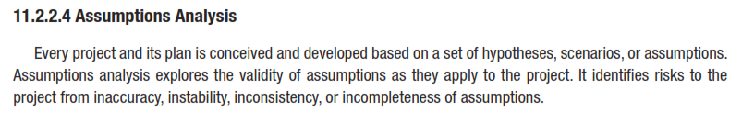
ASSUMPTIONS ANALYSIS

Slide 44
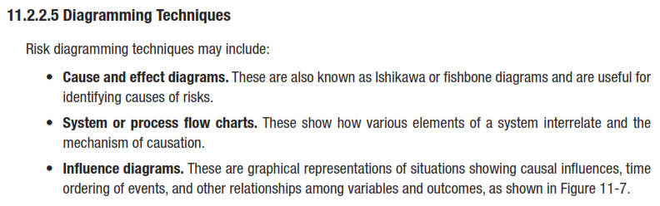
DIAGRAMMING TECHNIQUES

Slide 45
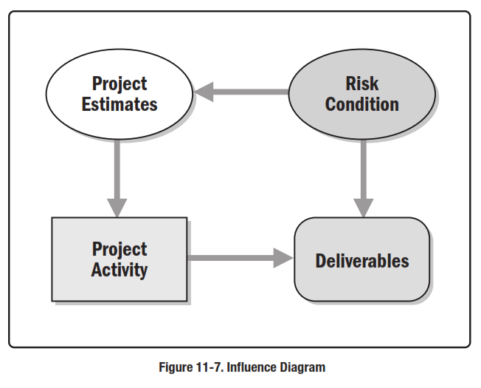
INFLUENCE DIAGRAM

Slide 46
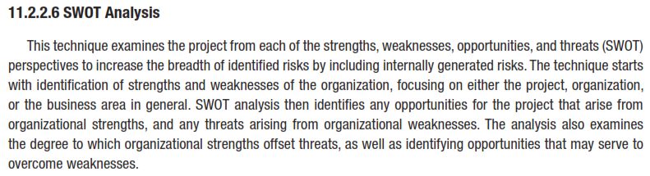
SWOT ANALYSIS

Slide 47
SWOT
Strengths
Weaknesses
Internal
Build On
Eliminate or Reduce
Opportunities
Threats
External
Exploit
Mitigate

Slide 48
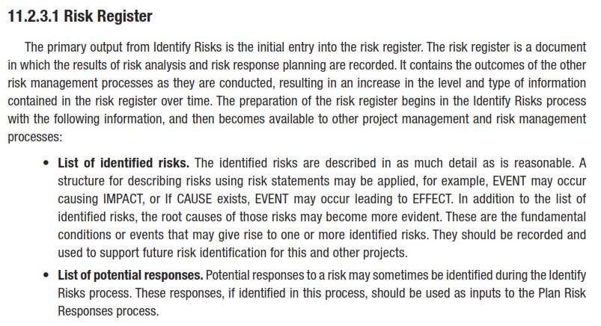
RISK REGISTER

Slide 49
IDENTIFY RISK PROCESS
Inputs to the Process
UNIT 7
Project Charter
Risk Management Plan
Output from project planning – such as the
  work breakdown structure,
  estimates and
  management plans
List of common risk categories
Historical records and project documents
Stakeholder register
From Rita Mulcahy’s Risk Management – Tricks of the Trade for Project Managers, and PMI-RMP® Exam Prep Guide, 2nd Ed
Notes:
ROLE OF PROJECT RISK MGMT
In Corporate Business Management
Two Basic Types in Corporate Business Management:-
Business Risk
Inherent chances of both profit and loss associated with the particular business endeavor.
Business entities employ skilled staff to increase the chances of profit and reduce the chances of loss.
The essential purpose is to maximize profits.
Pure or Insurable Risk
Involves only a chance for loss and no chance for profit.
Insurable risks can be further sub-divided into four categories:-
Direct property loss
Indirect property loss
Liability loss
Personal loss

Slide 50
IDENTIFY RISK PROCESS
Determine What Additional Information is Needed?
UNIT 7
Have a complete
  Scope of work and
  Complete Requirements
    before you begin Identify Risks process.
“Unclear requirements or scope of work are a risk to the project and almost always have a negative cost and schedule impact.”
From Rita Mulcahy’s Risk Management – Tricks of the Trade for Project Managers, and PMI-RMP® Exam Prep Guide, 2nd Ed
Notes:
ROLE OF PROJECT RISK MGMT
In Corporate Business Management
Two Basic Types in Corporate Business Management:-
Business Risk
Inherent chances of both profit and loss associated with the particular business endeavor.
Business entities employ skilled staff to increase the chances of profit and reduce the chances of loss.
The essential purpose is to maximize profits.
Pure or Insurable Risk
Involves only a chance for loss and no chance for profit.
Insurable risks can be further sub-divided into four categories:-
Direct property loss
Indirect property loss
Liability loss
Personal loss

Slide 51
IDENTIFY RISK PROCESS
Reasons Requirements are Difficult to Determine
UNIT 7
Stakeholders grab onto the first or most obvious solution to a problem instead of working toward the best solutions.
Changing environments.
Differences in language or culture.
Lack of support from management.
Determining requirements seems to take too much time.
Inexperienced project manager.
Unclear methodology for determining requirements.
Lack of historical records.
Tendency to avoid arguments.
Bureaucratic problems require the team to start the work before there is a final determination about what the organization wants.
Stakeholders are trying to fast track the project.
Stakeholders do not realize the consequences of providing unclear requirements.
Stakeholders do not want to commit in case they change their minds later, keeping options open.
From Rita Mulcahy’s Risk Management – Tricks of the Trade for Project Managers, and PMI-RMP® Exam Prep Guide, 2nd Ed
Notes:
ROLE OF PROJECT RISK MGMT
In Corporate Business Management
Two Basic Types in Corporate Business Management:-
Business Risk
Inherent chances of both profit and loss associated with the particular business endeavor.
Business entities employ skilled staff to increase the chances of profit and reduce the chances of loss.
The essential purpose is to maximize profits.
Pure or Insurable Risk
Involves only a chance for loss and no chance for profit.
Insurable risks can be further sub-divided into four categories:-
Direct property loss
Indirect property loss
Liability loss
Personal loss

Slide 52
IDENTIFY RISK PROCESS
Show Them the Consequences
UNIT 7
Because the customer is not sure of the functionality of the X system, changes are expected. For every change in this area, there will be 3-6 day delay of the project with a US$10,000 to US$20,000 cost for each occurrence.
Because there is a lack of final approval of the feasibility of the X system design, component changes are expected. For every change, there will be at least a 2-week delay and a US$12,000 to US$21,000 impact.
From Rita Mulcahy’s Risk Management – Tricks of the Trade for Project Managers, and PMI-RMP® Exam Prep Guide, 2nd Ed
Notes:
ROLE OF PROJECT RISK MGMT
In Corporate Business Management
Two Basic Types in Corporate Business Management:-
Business Risk
Inherent chances of both profit and loss associated with the particular business endeavor.
Business entities employ skilled staff to increase the chances of profit and reduce the chances of loss.
The essential purpose is to maximize profits.
Pure or Insurable Risk
Involves only a chance for loss and no chance for profit.
Insurable risks can be further sub-divided into four categories:-
Direct property loss
Indirect property loss
Liability loss
Personal loss

Slide 53
IDENTIFY RISK PROCESS
Determining Who Has Insight into Risks
UNIT 7
Gain support for Risk Identification Before You Begin
Look Throughout the Organization for Risks and Risk Responses
Use Published articles
Use Involvement with Associations
Utilize Your Competition
Include Your Customers
Who Else Should be Involved?
Limit the Use of Software
Plan for Risk Identification Meetings
Meet Face-to-Face if Possible
Risk Identification With Virtual Teams
Meet Offsite
Properly Name Risks
From Rita Mulcahy’s Risk Management – Tricks of the Trade for Project Managers, and PMI-RMP® Exam Prep Guide, 2nd Ed
Notes:
ROLE OF PROJECT RISK MGMT
In Corporate Business Management
Two Basic Types in Corporate Business Management:-
Business Risk
Inherent chances of both profit and loss associated with the particular business endeavor.
Business entities employ skilled staff to increase the chances of profit and reduce the chances of loss.
The essential purpose is to maximize profits.
Pure or Insurable Risk
Involves only a chance for loss and no chance for profit.
Insurable risks can be further sub-divided into four categories:-
Direct property loss
Indirect property loss
Liability loss
Personal loss

Slide 54
IDENTIFY RISK PROCESS
Cause-Risk-Effect Format
UNIT 7
It is NOT a Risk
Not being co-located is not the root cause of this risk.
With a little further investigation the real cause and risk might be uncovered.
Cause | Risk | Effect
Due to the team not being co-located, | Communications might take a long time, | Which may lead to milestones being missed.
Cause | Risk | Effect
As a result of the project manager’s inexperience with virtual teams, | Work may take more than allocated in the schedule, | Which may lead to milestones being missed.
From Rita Mulcahy’s Risk Management – Tricks of the Trade for Project Managers, and PMI-RMP® Exam Prep Guide, 2nd Ed
Notes:
ROLE OF PROJECT RISK MGMT
In Corporate Business Management
Two Basic Types in Corporate Business Management:-
Business Risk
Inherent chances of both profit and loss associated with the particular business endeavor.
Business entities employ skilled staff to increase the chances of profit and reduce the chances of loss.
The essential purpose is to maximize profits.
Pure or Insurable Risk
Involves only a chance for loss and no chance for profit.
Insurable risks can be further sub-divided into four categories:-
Direct property loss
Indirect property loss
Liability loss
Personal loss

Slide 55
IDENTIFY RISK PROCESS
Cause-Risk-Effect Format
UNIT 7
It is NOT a Risk
Not being co-located is not the root cause of this risk.
With a little further investigation the real cause and risk might be uncovered.
Cause | Risk | Effect
Due to the team not being co-located, | Communications might take a long time, | Which may lead to milestones being missed.
Cause | Risk | Effect
As a result of the project manager’s inexperience with virtual teams, | Work may take more than allocated in the schedule, | Which may lead to milestones being missed.
From Rita Mulcahy’s Risk Management – Tricks of the Trade for Project Managers, and PMI-RMP® Exam Prep Guide, 2nd Ed
Notes:
ROLE OF PROJECT RISK MGMT
In Corporate Business Management
Two Basic Types in Corporate Business Management:-
Business Risk
Inherent chances of both profit and loss associated with the particular business endeavor.
Business entities employ skilled staff to increase the chances of profit and reduce the chances of loss.
The essential purpose is to maximize profits.
Pure or Insurable Risk
Involves only a chance for loss and no chance for profit.
Insurable risks can be further sub-divided into four categories:-
Direct property loss
Indirect property loss
Liability loss
Personal loss

Slide 56
IDENTIFY RISK PROCESS
Cause-Risk-Effect Format
UNIT 7
Following Risk does NOT have enough detail
Cause | Risk | Effect
The market research function stopped focusing on the product while doing marketing research, | Thus missing a new trend in requirements, | Resulting in scope change.
From Rita Mulcahy’s Risk Management – Tricks of the Trade for Project Managers, and PMI-RMP® Exam Prep Guide, 2nd Ed
Notes:
ROLE OF PROJECT RISK MGMT
In Corporate Business Management
Two Basic Types in Corporate Business Management:-
Business Risk
Inherent chances of both profit and loss associated with the particular business endeavor.
Business entities employ skilled staff to increase the chances of profit and reduce the chances of loss.
The essential purpose is to maximize profits.
Pure or Insurable Risk
Involves only a chance for loss and no chance for profit.
Insurable risks can be further sub-divided into four categories:-
Direct property loss
Indirect property loss
Liability loss
Personal loss

Slide 57
IDENTIFY RISK PROCESS
Cause-Risk-Effect Format
UNIT 7
A well-worded risk would be:
Cause | Risk | Effect
The number of inches apart the seats should be spaced will depend on market research, which, due to changing consumer needs, will not be done until late in the project. The market research department has many products it will be researching, | Which may mean that seat-spacing requirements could be ignored or come even later than planned. | Causing the need to eliminate one row of seats and redesign the locking mechanism if the research shows changes in needs.
From Rita Mulcahy’s Risk Management – Tricks of the Trade for Project Managers, and PMI-RMP® Exam Prep Guide, 2nd Ed
Notes:
ROLE OF PROJECT RISK MGMT
In Corporate Business Management
Two Basic Types in Corporate Business Management:-
Business Risk
Inherent chances of both profit and loss associated with the particular business endeavor.
Business entities employ skilled staff to increase the chances of profit and reduce the chances of loss.
The essential purpose is to maximize profits.
Pure or Insurable Risk
Involves only a chance for loss and no chance for profit.
Insurable risks can be further sub-divided into four categories:-
Direct property loss
Indirect property loss
Liability loss
Personal loss

Slide 58
IDENTIFY RISK PROCESS
Cause-Risk-Effect Format
UNIT 7
Cause may not really be a Cause but Threat. Let’s look at the following example:
Cause | Risk | Effect
The system backup/disaster recovery mechanism may not work, | Which could lead to a loss of programming code or data structures and test data developed to date, | None provided
From Rita Mulcahy’s Risk Management – Tricks of the Trade for Project Managers, and PMI-RMP® Exam Prep Guide, 2nd Ed
Notes:
ROLE OF PROJECT RISK MGMT
In Corporate Business Management
Two Basic Types in Corporate Business Management:-
Business Risk
Inherent chances of both profit and loss associated with the particular business endeavor.
Business entities employ skilled staff to increase the chances of profit and reduce the chances of loss.
The essential purpose is to maximize profits.
Pure or Insurable Risk
Involves only a chance for loss and no chance for profit.
Insurable risks can be further sub-divided into four categories:-
Direct property loss
Indirect property loss
Liability loss
Personal loss

Slide 59
IDENTIFY RISK PROCESS
Cause-Risk-Effect Format
UNIT 7
Knowing the real cause will be critical to analyzing the threat in Perform Qualitative Risk Analysis process:
Cause | Risk | Effect
There have been three instances in this company where the backup/recovery mechanism has not worked. Though the system is being investigated, no changes will occur before this project is completed, | Which means the system backup/disaster recovery mechanism may not work, | Which could lead to loss of programming code or data structures and test data developed to date.
From Rita Mulcahy’s Risk Management – Tricks of the Trade for Project Managers, and PMI-RMP® Exam Prep Guide, 2nd Ed
Notes:
ROLE OF PROJECT RISK MGMT
In Corporate Business Management
Two Basic Types in Corporate Business Management:-
Business Risk
Inherent chances of both profit and loss associated with the particular business endeavor.
Business entities employ skilled staff to increase the chances of profit and reduce the chances of loss.
The essential purpose is to maximize profits.
Pure or Insurable Risk
Involves only a chance for loss and no chance for profit.
Insurable risks can be further sub-divided into four categories:-
Direct property loss
Indirect property loss
Liability loss
Personal loss

Slide 60
IDENTIFY RISK PROCESS
Cause-Risk-Effect Format
UNIT 7
Causes are Needed
  Detailed cause help understand potential threat
  Ideas for responses to the threat are easily conceived
Cause | Risk | Effect
Because the contract is a time and materials contract, unlike previous releases that were done under fixed price contracts, and because the supplier is seldom critical of a customer-requested change, | Scope could creep, | Which could cause the project to be late and more costly.
From Rita Mulcahy’s Risk Management – Tricks of the Trade for Project Managers, and PMI-RMP® Exam Prep Guide, 2nd Ed
Notes:
ROLE OF PROJECT RISK MGMT
In Corporate Business Management
Two Basic Types in Corporate Business Management:-
Business Risk
Inherent chances of both profit and loss associated with the particular business endeavor.
Business entities employ skilled staff to increase the chances of profit and reduce the chances of loss.
The essential purpose is to maximize profits.
Pure or Insurable Risk
Involves only a chance for loss and no chance for profit.
Insurable risks can be further sub-divided into four categories:-
Direct property loss
Indirect property loss
Liability loss
Personal loss

Slide 61
IDENTIFY RISK PROCESS
Cause-Risk-Effect Format
UNIT 7
Effects can be more than Just Time and Cost
It would not be accurate to list “delayed project” as effect here:
Cause | Risk | Effect
We are not able to maintain a good relationship with customer, | Causing lack of trust with customer, | Which may require more meetings and extra hand-holding.
Cause | Risk | Effect
We are not able to maintain a good relationship with customer, | Causing lack of trust with customer, | Delayed project
From Rita Mulcahy’s Risk Management – Tricks of the Trade for Project Managers, and PMI-RMP® Exam Prep Guide, 2nd Ed
Notes:
ROLE OF PROJECT RISK MGMT
In Corporate Business Management
Two Basic Types in Corporate Business Management:-
Business Risk
Inherent chances of both profit and loss associated with the particular business endeavor.
Business entities employ skilled staff to increase the chances of profit and reduce the chances of loss.
The essential purpose is to maximize profits.
Pure or Insurable Risk
Involves only a chance for loss and no chance for profit.
Insurable risks can be further sub-divided into four categories:-
Direct property loss
Indirect property loss
Liability loss
Personal loss

Slide 62
IDENTIFY RISK PROCESS
Cause-Risk-Effect Format
UNIT 7
A Threat is NOT an Excuse for Poor Project Management
This does not get to the root cause of the impact.
Issues like lack of support or resources MUST be dealt with before the project starts.
The project management plan must be achievable and bought-into before starting work.
There is no other ethical option for a project manager.
Cause | Risk | Effect
Due to upper management not supporting the project, | Resources will not be available, | Resulting in not being able to complete the project on time.
From Rita Mulcahy’s Risk Management – Tricks of the Trade for Project Managers, and PMI-RMP® Exam Prep Guide, 2nd Ed
Notes:
ROLE OF PROJECT RISK MGMT
In Corporate Business Management
Two Basic Types in Corporate Business Management:-
Business Risk
Inherent chances of both profit and loss associated with the particular business endeavor.
Business entities employ skilled staff to increase the chances of profit and reduce the chances of loss.
The essential purpose is to maximize profits.
Pure or Insurable Risk
Involves only a chance for loss and no chance for profit.
Insurable risks can be further sub-divided into four categories:-
Direct property loss
Indirect property loss
Liability loss
Personal loss

Slide 63
IDENTIFY RISK PROCESS
Other Tricks of the Trade
UNIT 7
Make separate lists of threats and Opportunities to prevent identifying only threats.
Risks should be clarified.
Include risks relating to integration
Look at assumptions
Quantity is Quality
Dealing with Team Member discouragement
From Rita Mulcahy’s Risk Management – Tricks of the Trade for Project Managers, and PMI-RMP® Exam Prep Guide, 2nd Ed
Notes:
ROLE OF PROJECT RISK MGMT
In Corporate Business Management
Two Basic Types in Corporate Business Management:-
Business Risk
Inherent chances of both profit and loss associated with the particular business endeavor.
Business entities employ skilled staff to increase the chances of profit and reduce the chances of loss.
The essential purpose is to maximize profits.
Pure or Insurable Risk
Involves only a chance for loss and no chance for profit.
Insurable risks can be further sub-divided into four categories:-
Direct property loss
Indirect property loss
Liability loss
Personal loss

Slide 64
IDENTIFY RISK PROCESS
Methods of Documenting Risks
UNIT 7
Forms
Checklists
Sticky Notes
From Rita Mulcahy’s Risk Management – Tricks of the Trade for Project Managers, and PMI-RMP® Exam Prep Guide, 2nd Ed
Notes:
ROLE OF PROJECT RISK MGMT
In Corporate Business Management
Two Basic Types in Corporate Business Management:-
Business Risk
Inherent chances of both profit and loss associated with the particular business endeavor.
Business entities employ skilled staff to increase the chances of profit and reduce the chances of loss.
The essential purpose is to maximize profits.
Pure or Insurable Risk
Involves only a chance for loss and no chance for profit.
Insurable risks can be further sub-divided into four categories:-
Direct property loss
Indirect property loss
Liability loss
Personal loss

Slide 65
IDENTIFY RISK PROCESS
Methods to Identify Risks
UNIT 7
Use a Prompt List
Review the list of risks provided in books
Review your own company’s Historical Records
Brainstorming
Conduct a “Pre-Mortem”
Affinity Diagrams
Expert Interviews
Nominal Group Technique
Delphi Technique
Cause and Effect Diagram
Failure Modes and Effects Analysis
SWOT Analysis
From Rita Mulcahy’s Risk Management – Tricks of the Trade for Project Managers, and PMI-RMP® Exam Prep Guide, 2nd Ed
Notes:
ROLE OF PROJECT RISK MGMT
In Corporate Business Management
Two Basic Types in Corporate Business Management:-
Business Risk
Inherent chances of both profit and loss associated with the particular business endeavor.
Business entities employ skilled staff to increase the chances of profit and reduce the chances of loss.
The essential purpose is to maximize profits.
Pure or Insurable Risk
Involves only a chance for loss and no chance for profit.
Insurable risks can be further sub-divided into four categories:-
Direct property loss
Indirect property loss
Liability loss
Personal loss

Slide 66
IDENTIFY RISK PROCESS
Tricks for Identifying More Risks
UNIT 7
Equalize Participation
Use Anonymity
Virtual Teams
Use a Combination of Methods
From Rita Mulcahy’s Risk Management – Tricks of the Trade for Project Managers, and PMI-RMP® Exam Prep Guide, 2nd Ed
Notes:
ROLE OF PROJECT RISK MGMT
In Corporate Business Management
Two Basic Types in Corporate Business Management:-
Business Risk
Inherent chances of both profit and loss associated with the particular business endeavor.
Business entities employ skilled staff to increase the chances of profit and reduce the chances of loss.
The essential purpose is to maximize profits.
Pure or Insurable Risk
Involves only a chance for loss and no chance for profit.
Insurable risks can be further sub-divided into four categories:-
Direct property loss
Indirect property loss
Liability loss
Personal loss

Slide 67
IDENTIFY RISK PROCESS
Steps of the Identify Risks Process
UNIT 7
Collect historical information
Determine who may have insight into the risks
Determine which risk identification methods to use
Identify risks with others
Make a list of all identified risks on a risk register
Determine confidence level in major risk identification
Determine still unanswered questions and missing information
Ask the remaining questions and collect information
Add new risks to the list and eliminate any items identified as not really risks in your data collection
Discuss remaining risks as necessary to understand them
Mark and number all risks and record them
Move on to the Perform Qualitative Risk Analysis process
From Rita Mulcahy’s Risk Management – Tricks of the Trade for Project Managers, and PMI-RMP® Exam Prep Guide, 2nd Ed
Notes:
ROLE OF PROJECT RISK MGMT
In Corporate Business Management
Two Basic Types in Corporate Business Management:-
Business Risk
Inherent chances of both profit and loss associated with the particular business endeavor.
Business entities employ skilled staff to increase the chances of profit and reduce the chances of loss.
The essential purpose is to maximize profits.
Pure or Insurable Risk
Involves only a chance for loss and no chance for profit.
Insurable risks can be further sub-divided into four categories:-
Direct property loss
Indirect property loss
Liability loss
Personal loss

Slide 68
IDENTIFY RISK PROCESS
Outputs of the Process
UNIT 7
List of risks
Root causes of risks
Potential risk owners
List of potential responses
Triggers
Updated Risk Categories
From Rita Mulcahy’s Risk Management – Tricks of the Trade for Project Managers, and PMI-RMP® Exam Prep Guide, 2nd Ed
Notes:
ROLE OF PROJECT RISK MGMT
In Corporate Business Management
Two Basic Types in Corporate Business Management:-
Business Risk
Inherent chances of both profit and loss associated with the particular business endeavor.
Business entities employ skilled staff to increase the chances of profit and reduce the chances of loss.
The essential purpose is to maximize profits.
Pure or Insurable Risk
Involves only a chance for loss and no chance for profit.
Insurable risks can be further sub-divided into four categories:-
Direct property loss
Indirect property loss
Liability loss
Personal loss

Slide 69
UNIT 7
Review Questions

Slide 70
The End
THE END
THANK YOU

Slide 71


